Slide 1
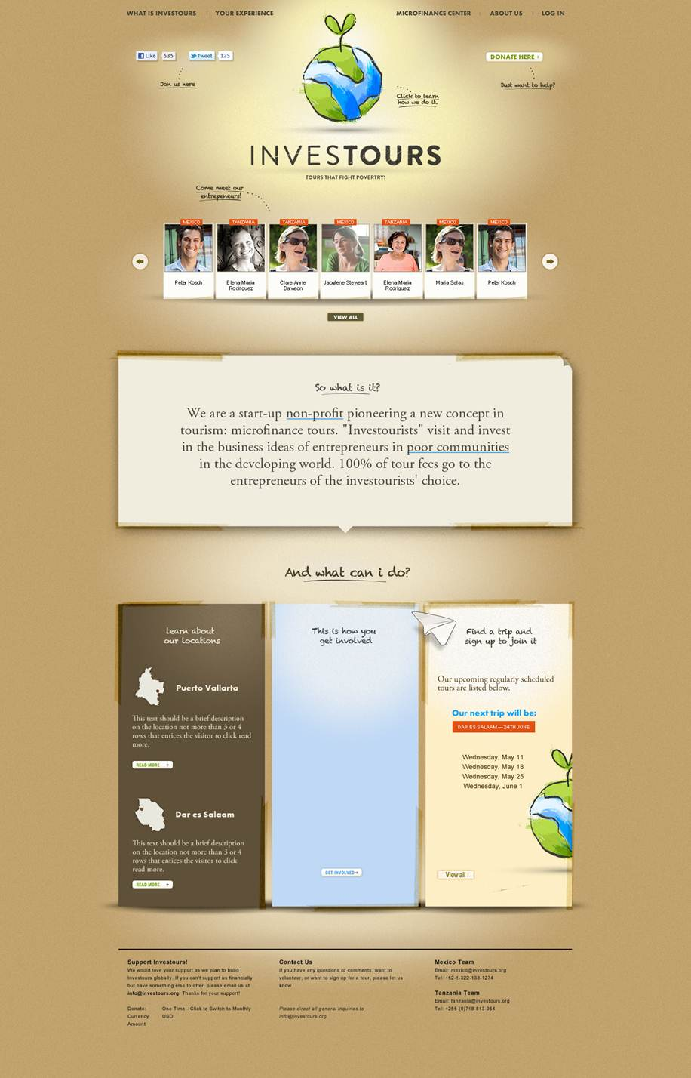
Notes:
Front Page
Note that the bar at the top should be dark as in the later designs.
The sliding showcase depicts the faces and names of select entrepreneurs from our database. Assuming we are going for the full website, the entrepreneur summary and other buttons (see next slide) appear in the "So what is it?" box when clicked. When the mouse hovers over an individual's card/box, that card/box will be highlighted and the entrepreneur content in the "So what is it?" box should show up temporarily until mouseover ends so that the user knows that upon clicking, they can see that information.
The specific menus will depend on the Site Map, which I will put together if we are going forward with this.
The content of the three panels on the bottom remains to be decided, but would likely be something along the lines of (1) Locations, (2) Investours in 3 steps or something which explains what we do, and (3) Latest news/posts from our blog.

Slide 2
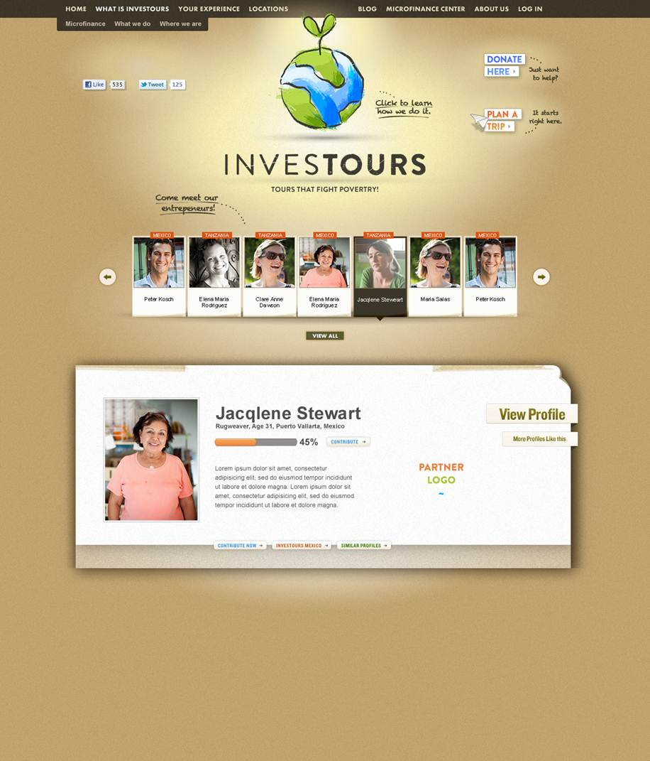
Notes:
Front Page – *Entrepreneur Box"
When an entrepreneur is clicked (or hovered over), the content of the "So what is it?" box changes to the design shown here.
Entrepreneurs that will be showcased need to be able to be selected from the backend.
The Partner Logo will link to the Partner Page
View Profile will link to the specific Entrepreneur Profile Page
Contribute Now will lead to a contribution form which should pop-up. I think it's best that this button lead to the Entrepreneur Profile Page and then have the pop-up contribution form be displayed as a pop-up/light box.
Investours "Location" will link to the Location Page
Similar Profiles will link to the All Entrepreneurs Page, sorted for that location's other entrepreneurs.
Instead of "More Profiles Like this" on the right hand side, we should have a button that says "How it works" that will lead to a page that describes our program and the microfinance process.
During Phase 1, before the Microfinance Center is built, these will all be "Success stories" that have neither the profile links nor the contribution options/status bar. After the whole site is completed, we may still want the option of creating "exhibition profiles" that show up as success stories rather than as active profiles for projects.
The Donate Here and Plan a Trip buttons on the top right should follow the style on this page. The actual text is TBD. The Donate Here button (more likely "Support Us") will lead to the support pop-up lightbox described later. The Plan a Trip (more likely Sign-Up Now) button will lead to the Tour Sign-Up Page.

Slide 3
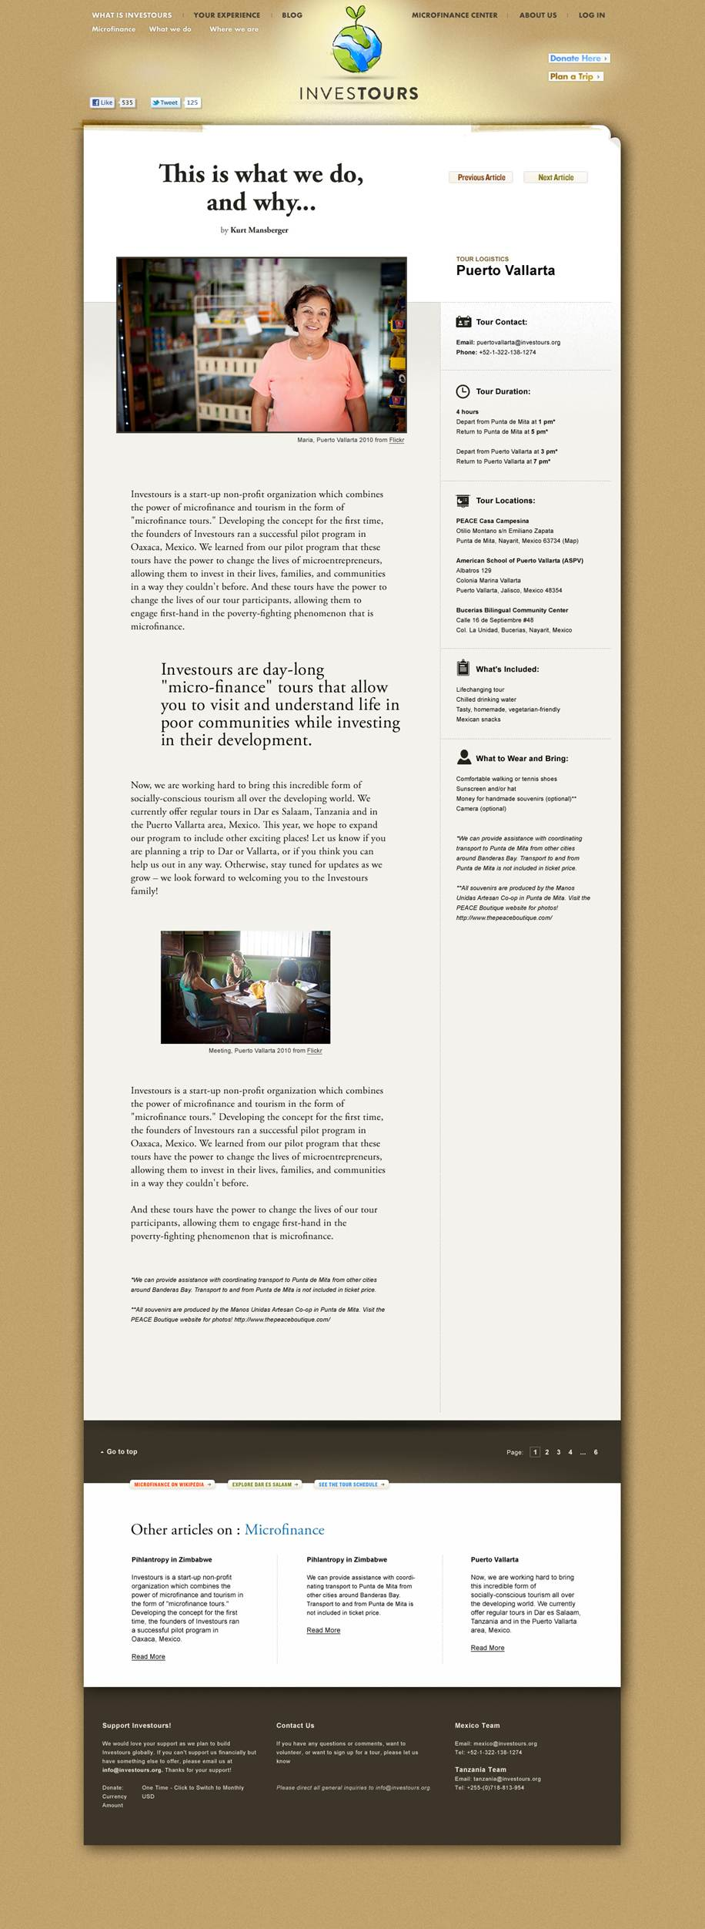
Notes:
Article Page
With specific tweaks, this should be the core style for all the main content pages unless otherwise specified.
This should also be the general style of the Investours blog.
There doesn't appear to be a good navigation map on here, so that might be something that we need to add in a reasonable place. (e.g. right bar, upper right, top of white space)
The featured articles on the bottom of the page should be drawn from our blog posts/latest news (same thing, I think).
Not sure yet what exactly to do with the buttons above the featured article strip (the first one is Microfinance on Wikipedia). Will let you know when creating the Site Map.
The actual content on the bottom of the page (Support Investours!, Contact Us, Mexico/Tanzania Team) will need to be determined later as well with the Site Map.

Slide 4
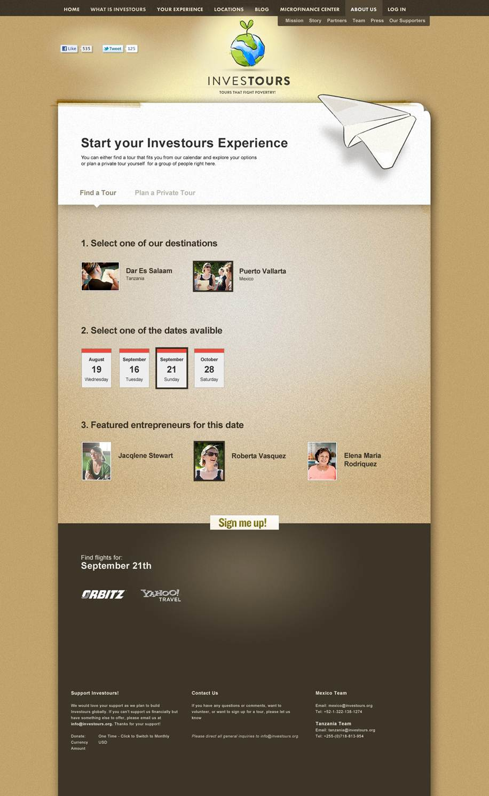
Notes:
Tour Sign-Up Page
This should be the interface for tour sign-ups.
Wording needs to be fixed across the board (e.g. #1 here should be "Select one of our locations." or "Pick a location")
Once a location is selected in #1, (this doesn't show up on here) the user should be able to enter their date range or just see all dates and the available tour dates populate accordingly. To the right, there should also be text that says "Plan a Private Tour" next to the available dates. If there are no available dates, it will just say "Plan a Private Tour."
Once a date is selected, #3 will appear. If it is a pre-scheduled tour and we know which entrepreneurs will be visited, then those entrepreneurs will show up in #3. Clicking the entrepreneur will take the user to the entrepreneur's profile page (without disturbing the flow, so it should be in a pop-up window). If it is a private tour or if the entrepreneurs have not yet been assigned to a pre-scheduled tour, then it should say "On your tour, you may meet entrepreneurs like…"
Clicking the "Sign me up!" button will create a pop-up light-box with the tour sign-up form. Details of the form content and how the money processing stuff needs to be determined.
If the user enters a date range, then the bottom will populate with "Find flights for" and insert their dates. Then, the user can click through and find flights on Orbitz, Yahoo, Kayak, etc. using those dates. I'm hoping that there might be some kind of affiliate program where Investours will get a small percentage of flights booked when linked through our site, but this is yet to be researched.

Slide 5
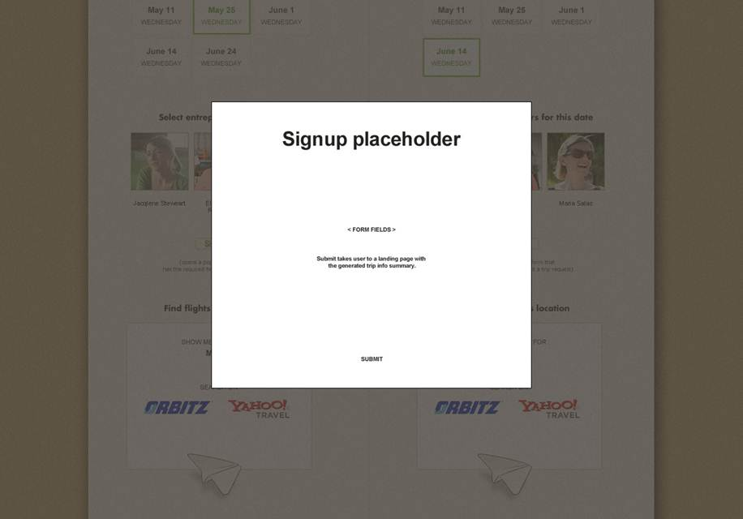
Notes:
Pop-up Lightbox thing
This kind of thing is what I mean when I refer to a pop-up lightbox. Not sure if there is a more accurate term to be used. Also, such boxes should all have a little X in the upper right corner.

Slide 6
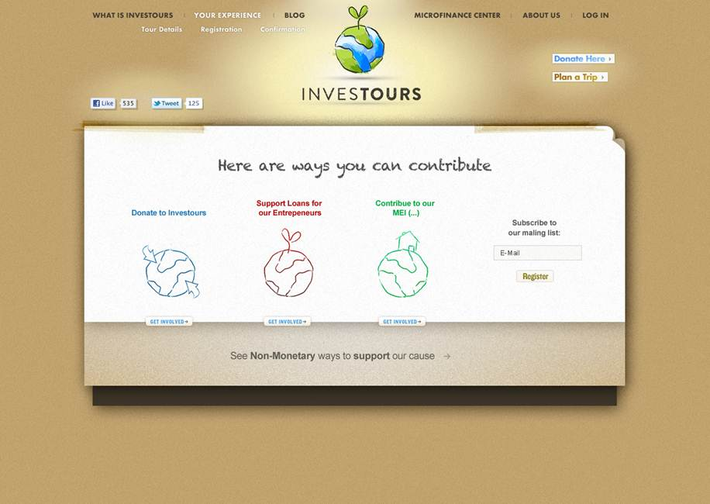
Notes:
Pop-Up Support Us
This should actually be in the form of a pop-up lightbox.
Donate to Investours should turn this into a form where the user can make a cash donation to Investours
Support Loans for Our Entrepreneurs should lead to the Microfinance Center full database page.
Contribute to our MFI Partners should turn this box into a listing of our MFI partners (currently just two or three). This hasn't been designed yet, but should generally fit in with the theme of this box.
Subscribe to our mailing list should connect to our MailChimp account.
Non-Monetary Ways to Support our Cause should link to a page that describes how to get involved (e.g. internships, employment, etc.)

Slide 7
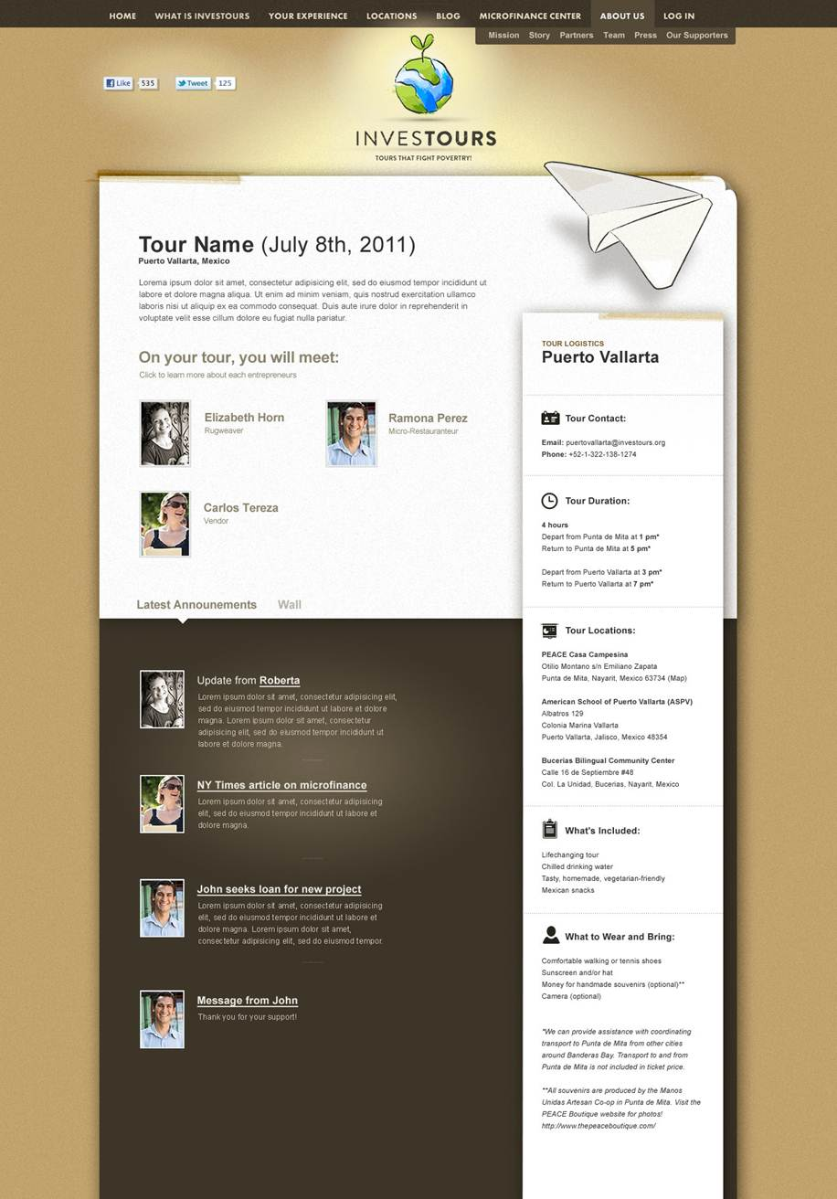
Notes:
Pre-Tour Page
This page provides key information for people once they sign-up for a tour. It contains:
Links to the Entrepreneur Profiles for entrepreneurs who will be visited. Before the entrepreneurs have been assigned, there should be a placeholder and a link to the All Enterepreneurs Page sorted for entrepreneurs in that location.
Vital tour logistics information (see the bar on the right hand side)
Announcements from Investours and a Wall for tour participants to communicate on the bottom.
After the tour, this page will be converted into a Group Page in the Microfinance Center.

Slide 8
Microfinance Center Map
Dashboard
Group Page
Front Page
Links in through Showcase
Entrepreneur Profile Page
All Entrepreneurs Page
Linked to side bar on all Microfinance Center Pages
Pages in GREEN fall within the "Microfinance Center." Pages in ORANGE are other pages which also display entrepreneurs from the database even if nominally outside the "Microfinance Center structure.
Pre-Tour Page
Location Page
Notes:
Microfinance Center Map
I thought this might be helpful to understand how the Microfinance Center works. I did this quickly, so there may be some holes in the logic/flow. There may also be some other pages that link to the All Entrepreneur Page (and possibly the other pages) that are not included here.

Slide 9
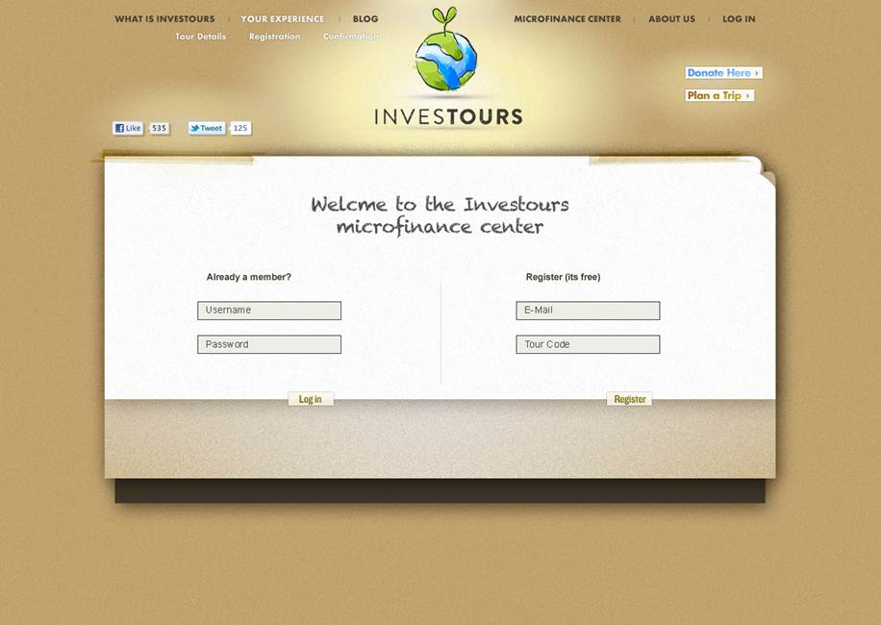
Notes:
Microfinance Center Log-In Page
This is how the user signs into his/her Microfinance Center account (can be done from anywhere on the site).
This should be a popup lightbox.
We need to create a registration form. Also, we will want to create a way for the user to sign in using a Tour Code (for example, if they haven't used the site before their tour, they might get Tour Code that fills in their information). Details yet to be determined.
We want people to be able to sign in with their Facebook and Google accounts. Maybe other platforms as well? We actually have a fairly active Facebook presence, so in the future we need to think about how to integrate that with our site. But this shouldn't hold us up for now.
Is there a way to link Facebook accounts with our site accounts, including after creation?

Slide 10
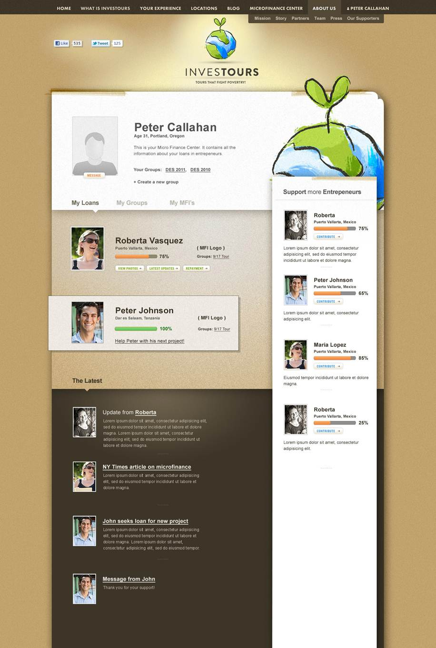
Notes:
Dashboard
This is the first page a registered user sees upon signing in. It displays all of the loans (both in progress and complete) and allows the user to access group pages, etc. Updates from all of the entrepreneur and group pages will show up under "The Latest".
Random entrepreneurs from the database will be displayed on the sidebar, with a link at the bottom that links to the All Entrepreneurs Page
Throughout the site, when money is still being raised for an entrepreneur, the status bar will be GREEN (different than above). When money has been raised and the loan is in repayment, the bar will be orange and depict repayment progress. When money is being raised (green bar), the text to the right of the bar will say "$X raised, $Y needed." When the loan is in repayment (orange bar), the text will read "Z% already repaid."
When a loan is repaid or if there is some other important status to alert the user to, the box will be highlighted (like Peter Johnson's box above) with an alert message below (in the sample, it says 'Help Peter with his next project!")
Updates from entrepreneur pages and group pages populate the "The Latest" box. Also, we should be able to issue system-wide Investours messages (even better if we can target them) that will show up in these feeds, too.
We won't add messaging between users at this stage – might get too messy – until we think more about it.
The user should be able to add a photo (make the "Message" button a "Add Photo" button).
NOTE: There needs to be some kind of navigation between pages within the Microfinance Center (and perhaps also connecting back to the rest of the site). One possible place might be along the top of the white section.

Slide 11
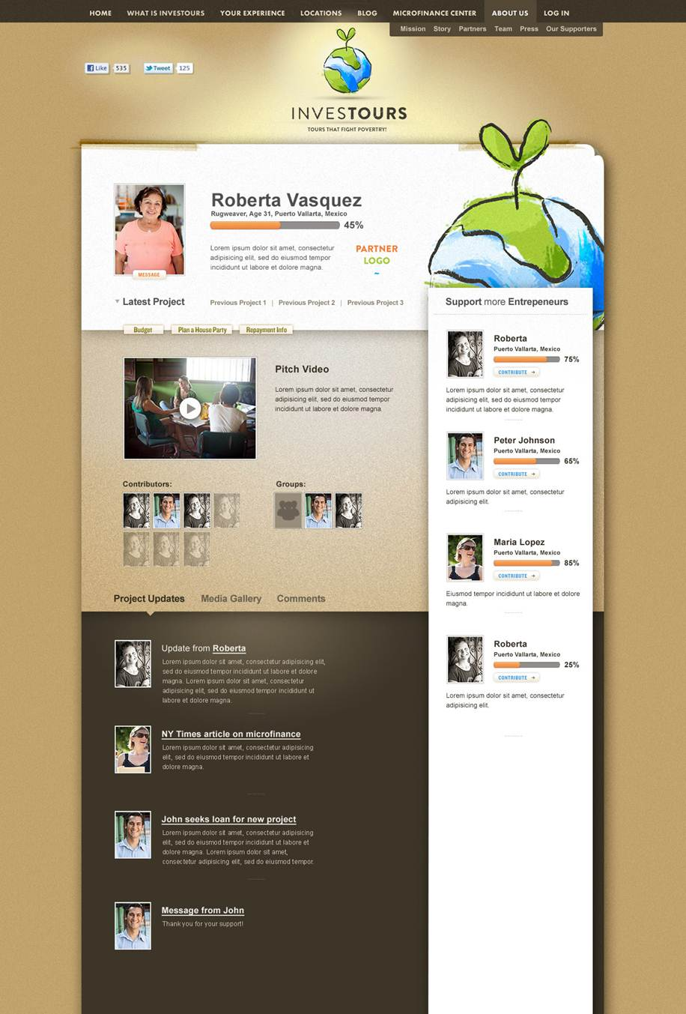
Notes:
Entrepreneur Profile Page
This is probably the most complex page to explain, and also the most important piece of the Microfinance Center.
There will be a pitch video (which can be replaced by an image or just text) to describe the project. Contributing individuals/groups will be listed below. After the loan is completely funded, we may or may not replace the pitch video with a thank you video.
As the entrepreneur pays off the loans, updates by our partner MFI or Investours will show up under Project Updates.
A media gallery will show photos of the entrepreneur
There will be a Wall where people can share messages about the project
There is also a link under the entrepreneur photo whereby people can send a message (perhaps for a small fee) to the entrepreneur. Our staff would translate the message and share it with the entrepreneur.
When photos are uploaded either on this page, users will also have the option of tagging the photo to one of their tour groups. When photos are uploaded on the Group page, the user will have the option of tagging the photo to one of their entrepreneurs.
The Latest Project is displayed by default. However, the user may view previous projects by clicking the relevant link.
Ex. Once an entrepreneur finishes paying off their first loan, they may want to seek a new loan. The new pitch becomes the default view, and the previous project gets listed as a past project accordingly and can be accessed by clicking the link. When the link is clicked, the new project slides down/appears in place of the Latest Project.
The Budget link will lead to a budget – not sure what this will look like exactly.
The Repayments link will lead to a more detailed list of repayment info. This would be populated using data input from the back-end by our MFI Partner (or Investours).
The Plan a House Party Link will automatically generate a download ZIP file containing PDF materials and video/photo content that can be used by a user for a "house party" fundraiser. We haven't designed these materials yet.

Slide 12
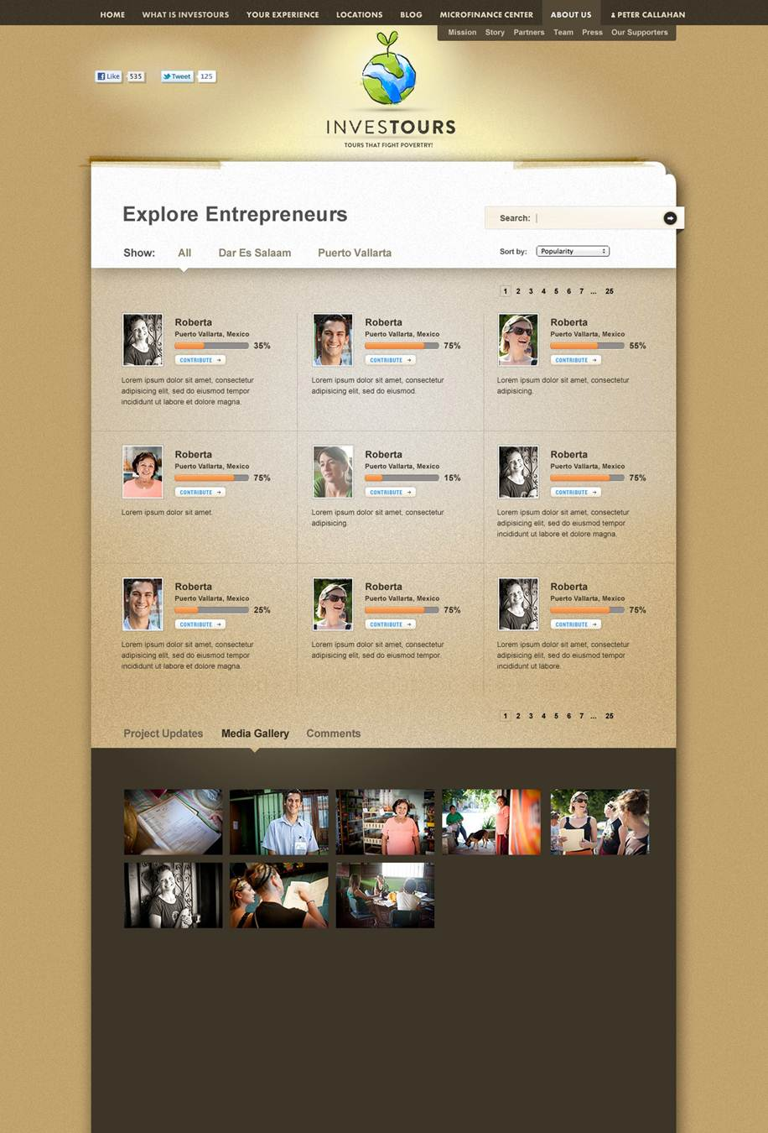
Notes:
All Entrepreneurs Page
This is the page that users arrive at from anywhere on the site where they can "See All Entrepreneurs", etc.
The entrepreneurs can be viewed by location as shown.
They can also be sorted by fundraising/repayment status. I can provide exact details of how to sort these.
Photos for the entrepreneurs displayed will populate below, just to add some color for people who are generally browsing.
Entrepreneurs should also be searchable using the search field.
We would not have the Project Updates and Comments which are in the design above.
There should be a view in which Investours can view all entrepreneurs, including non-public entrepreneurs. And the MFI should be able to view all of its non-public entrepreneurs as well.

Slide 13
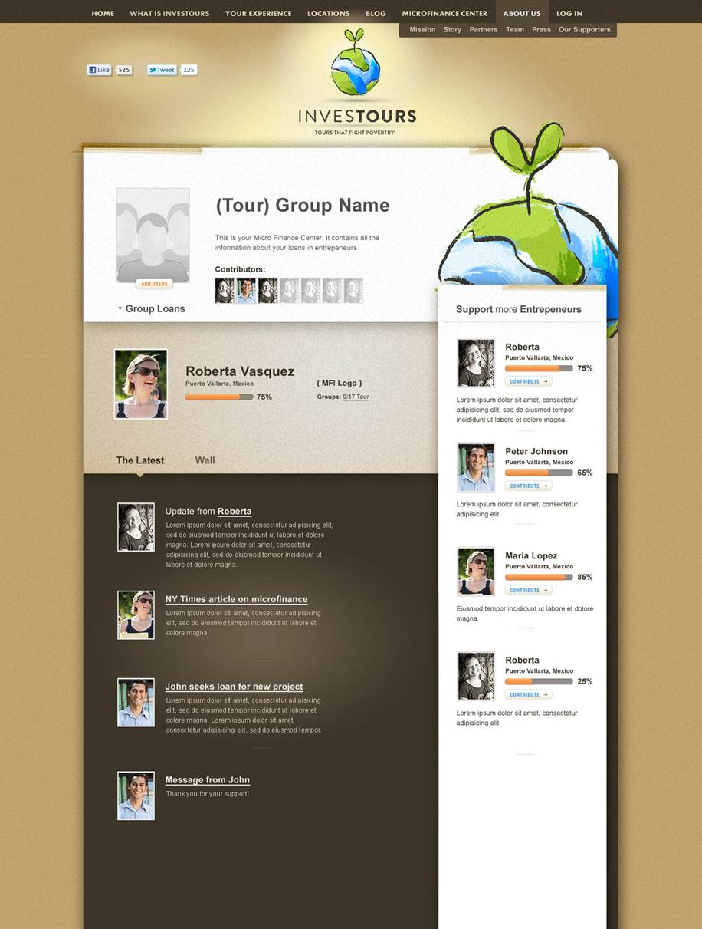
Notes:
Group Page
The Pre-Tour Page will turn into this Group Page automatically after a tour. Users may also create their own groups if they wish to in order to lend together.
This page works functionally almost exactly like the Dashboard, except it is for a group rather than an individual.
In addition to the Latest Updates section which is also found on the Individual Dashboard, the Group Page also adds in a Wall and a Photo Gallery. See explanation of photos on the Entrepreneur Profile Page notes.
The users should be able to create a profile photo for the group. The add users link should instead be next to Contributors (can just be text if that's easiest). When someone clicks add a user, we need to think about how they can do it without violating the privacy of the other users in the system (perhaps by entering in registered e-mail addresses?)

Slide 14
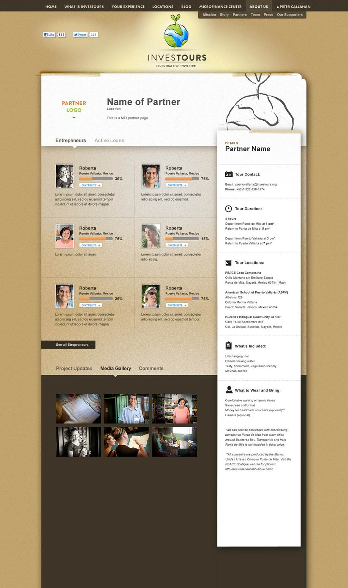
Notes:
Location Page
While this is labeled as the "Partner Page," I want this to be the "Location Page."
On the right hand side, there will be a description of our program in that location with a few links (e.g. "Our Team" which would lead to the About Us pages related to that location's leadership, "Our MFI Partners" which when clicked would lead to an article page for the MFI Partner, and "About Dar es Salaam" which would lead to an article page about the place).
Instead of Project Updates, we would have "Announcements"
It would be cool if in the comments section (or Wall) we could have our Facebook Page posts. Perhaps we would also want people who are just visiting this page but not logged in to Facebook to comment, though I'm not sure if that would make things confusing.
The Media Gallery would display photos from that location as well as perhaps photos from our Facebook pages for each location.
Note that the Location Page for our Puerto Vallarta section might instead be structured as an Article page, again linking to various other article pages describing the team, partner organizations, etc. It would be good for us to have the option of creating such pages when we have a new location in case we have a location that doesn't exactly fit into the normal mold is currently the case with Puerto Vallarta after our MFI partner closed down.

Slide 15
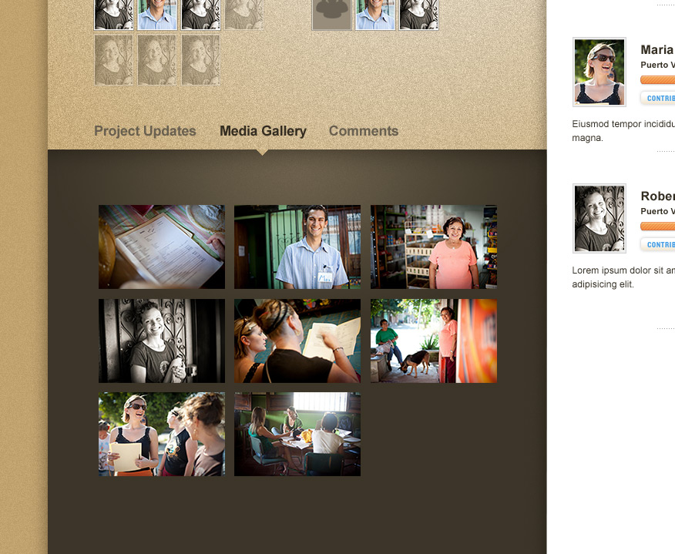
Notes:
Media Gallery
Not sure why, but there is an extra shot of the media gallery which will have our photos/videos. I think it is quite pretty. When you click, it should pop-up in a nice display lightbox format where you can scroll through photos. And on the Entrepreneur Profile and Group Pages, there should be a way for people to add their own photos. One thing we need to figure out is where to store the photos, or if we will require users to put them on Facebook first and somehow tag them in. Ideas?

Slide 16
Process
Tour Sign-Up (Front-End)
Approve Tour/Match Entrepreneurs (Investours)
Loan Disbursed (Investours)
TOUR! (Investours + Tourist)
Progress Updates (MFI)
Completion Confirmation (Investours)
Add Entrepreneur (MFI)
Add Project (MFI)
Edit & Approve Entrepreneur/Project
Add Video Pitch
(Investours)
ENTREPRENEUR DATABASE
Update Progress
(Investours/MFI)
User Registers, Optionally Creates Group
(Front-End)
Loan Disbursed (Investours)
User Browses Projects & Contributes as Individual or Group (Front-End)
Progress Updates (MFI)
Completion Confirmation (Investours)
Notes:
Backend Process Flow
I thought it might be helpful to, in rudimentary fashion, lay out the various steps.
There will need to be a front-end for the website, shown in the designs, and a back-end to manage the process and update content of both the informational pages and the Microfinance Center. The back-end should have a sub-interface that isolates functions for the MFI (though Investours should have the ability to fully access and play those roles as well). It would be best if the back-end interface tracked our organizational processes so that they mutually reinforce each other.
ENTREPRENEUR/PROJECT REGISTRATION
Add Entrepreneur – The MFI will input basic information about the entrepreneur. This will generate an Entrepreneur Profile Page once approved by Investours.
Add Project – The MFI will create a new project for an entrepreneur. The way this works is that projects are funded, not entrepreneurs, since a single entrepreneur might have multiple projects over time.
Investours Approval – Once a new entrepreneur/project is created, Investours will be notified and will be able to edit the information and add additional content such as the pitch video if that is something that the MFI doesn't do that on its part.
INVESTOURS EXPERIENCE PROCESS
There are two wings to this. One is the experience of someone who goes on our tours. The other is one who engages purely online. For the most part, these are similar and parallel, and they are described together below.
Sign-Up – In the tourist version, the tourist signs up for a tour and pays online. In doing so, the tourist may enter in basic info for each of the tour participants so that separate accounts will be made. The sign-up will generate user accounts and a Pre-Tour Group Page unless one has already been made for that tour (pre-scheduled tours). For purely online user, an individual user account is created, but a group is not created unless the user chooses to create one.
Tour Approval/Entrepreneur Matching (Tourists only)– Investours will approve (or edit) the tour (if rejected, then the payment will be refunded). When ready, Investours will add entrepreneurs to the tour. At appropriate times, e-mail updates will be provided to participating tourists.
Entrepreneur Browsing or Tour Day– Tourists meet entrepreneurs on tour-day and collectively decide how to allocate their tour fees (with the requirement that at least one project is fully funded) as a group. Purely online users browse entrepreneurs and may decide to contribute to projects either as individuals or in groups.
Investours disburses funds to MFI – Investours will approve the decision of the tourists/users and the funds for completed loans will be disbursed to the MFI. The Pre-Tour Page will be converted into a Group Page for the participating tourists, and their funds will be distributed and marked as if they were given by that Group in the Microfinance Center. Individual contributions from purely online users will only show up on individual dashboards, while Group contributions by purely online users as well as those for tour groups will be connected with both the Group Page and the Dashboards of the individuals making up the Group.
Progress Updates – The MFI must issue regular progress updates in line with the loan collection schedule (e.g. if loan is collected bi-weekly, then every two weeks), each time reporting how much was collected and providing at least 1-2 sentences on the status of the project. The updates will be shown on the Entrepreneur Page and will also be reflected in the repayment info and the status bar (orange). Updates will also be reflected on the feeds on individual Dashboards and, for group lenders/tourists, the relevant Group Pages.
When the project is complete or in default, the MFI may mark it as such.
Investours confirmation -- Investours will confirm the final status (completed, defaulted, etc.), and appropriate notifications will be sent.
Throughout this process, appropriate form e-mails will be sent out to contributors to keep them up to date (as indicated above as well as at other relevant points). These will need to be designed and created.
Again, within the Microfinance Center, a tour group will be considered to have given a group loan. People who have not gone on the tours will also be able to browse entrepreneurs/projects and contribute either individually or in groups. Once the loan is disbursed, the general process is the same for all participants, whether they contributed as part of a tour group, through a purely online group, or as individuals.

